Slide 1

C++ & DSA PLACEMENT COURSE
Khaiser Khanam

Slide 2

Variables and its Rules
1. Variable
2. Declaration and Initialization
3. Declare Multiple Variables
4. Update Value
5. Comments
6. Rules of naming variables

Slide 3
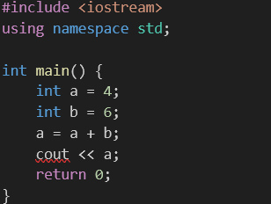
Homework
Q1. What will be the output of the following code?

Slide 4
Homework
Q2: Which of the following variable names are valid?
a) int 5stars;
b) int user_name;
c) int my-variable;
d) int string;
e) int totalSum123;

